Slide 1
Quantitative Research on Using Social Networking Site www.emama.mk as Online Community for Health Purposes
Marika Apostolova Trpkovska
Betim Cico

Slide 2
Presentation outline
Introduction
The reasons why a social network for moms ☺
The eMama.mk architecture
Presentation and results of the quantitative study
Conclusions and future works

Slide 3
Introduction
Social networks have become technology that is often used by the people and they represent a key instrument in people’s health support
Commercial web sites aim to attract people offering fast information
inappropriate when we want to include people in socialization
Online communities generally share the same goals, or they have something in common
First time mother related to children health
Online doctor + Facebook government organization + Forums + Web sites
Social network emama.mk that act as a online community
Ordinary (posting, commenting, forming groups) and dvanced (Immunization reminder & Children disease prediction) social services + online 24/7 doctor + children health information

Slide 4
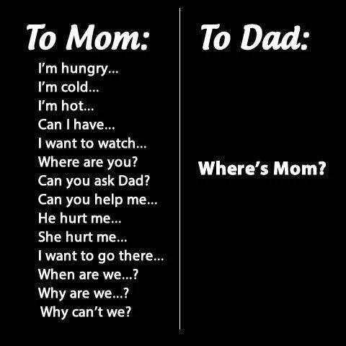
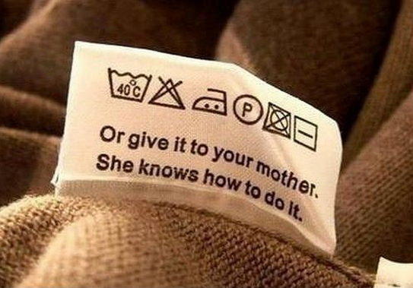
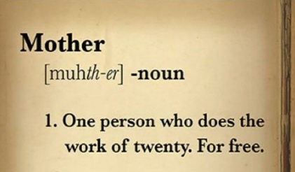
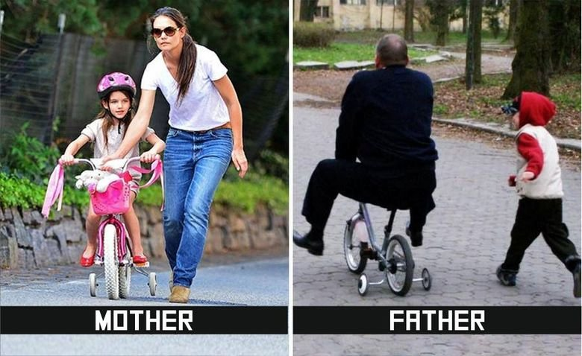
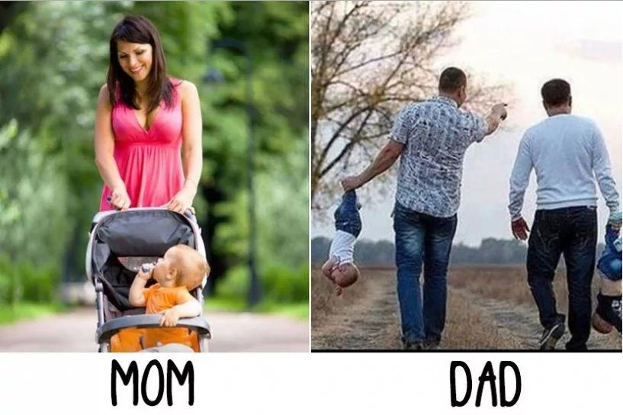
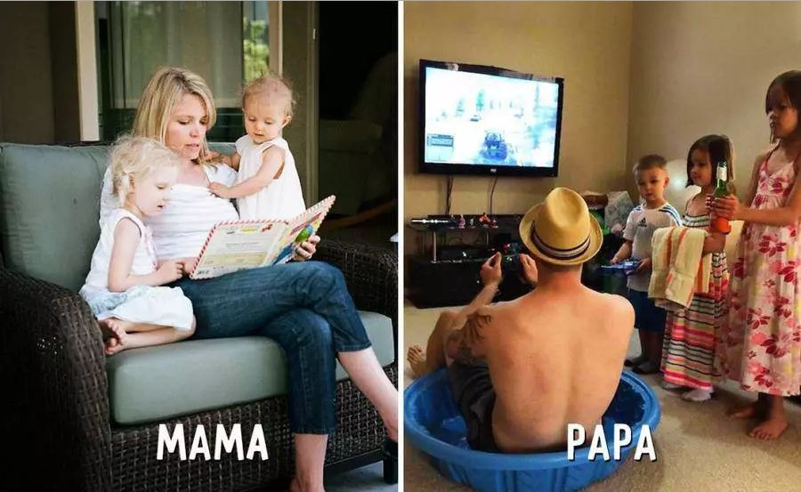
The reasons ☺

Slide 5
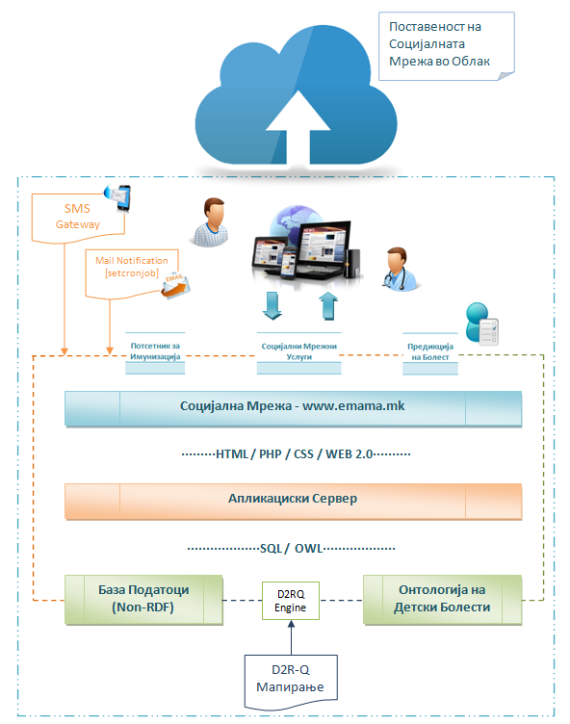
The architecture

Slide 6
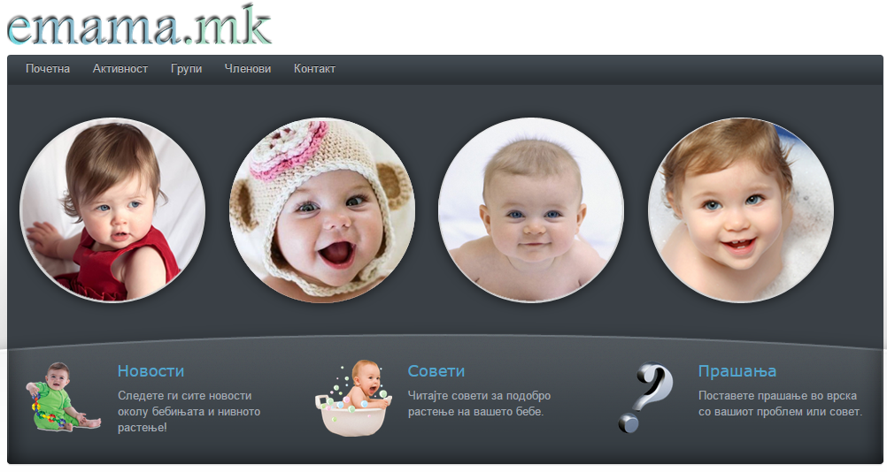
The research
A reflexive analysis to all data collected from one year experience of social network www.emama.mk was performed
The aim was to discover the users’ preferences of the system and to make a list of priorities for the future
50 users were included

Slide 7
The survey
32 closed questions
The questions were arranged in eight sections:
Demographics data;
Accessibility;
View;
Navigation;
Exceptions and handling statuses;
Online user support;
Learning;
Content and efficiency.

Slide 8
Gender & age

Slide 9
Q: Which statement most closely describes you

Slide 10
System accessibility

Slide 11
System design

Slide 12
System navigation

Slide 13
Exceptions and handling statuses

Slide 14
Online user support

Slide 15
Learning

Slide 16
Content and Efficiency

Slide 17
Conclusion and future works
We did a good job
Implementation of new services like pregnancy tracker
Language option (Albanian and English version)
Working on prediction tool

Slide 18
Thank you…

